Slide 1

Binary and computer logic
Lesson 1: Logic gates

Slide 2
Objectives
In this lesson, you will learn:
that digital devices rely on switches to make the decisions involved in data processing
how AND, OR and NOT logic gates operate
how to complete truth tables for logic gates
the significance of 1s and 0s in data processing within digital systems.

Slide 3
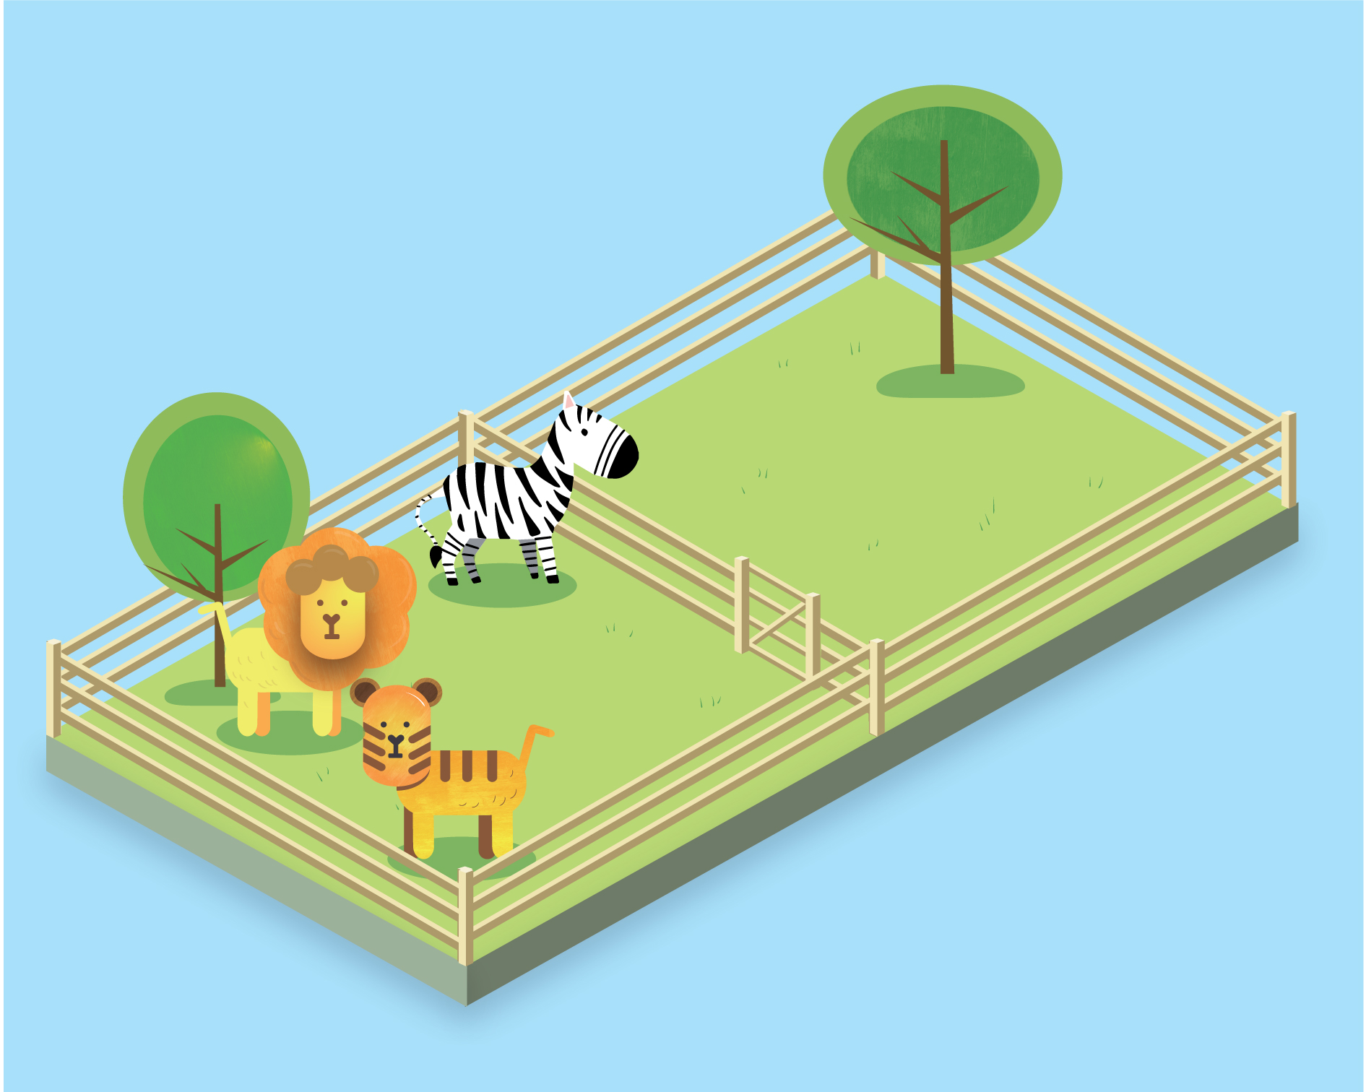
Animal sorting gate
A zookeeper has installed a digital sorting gate between two animal enclosures, to control which animals leave the first enclosure and enter the second enclosure.
The gate is programmed to allow only big cats with stripes through, so two things must happen for an animal to enter the second enclosure:
the animal must be a big cat
the animal must have stripes.

Slide 4
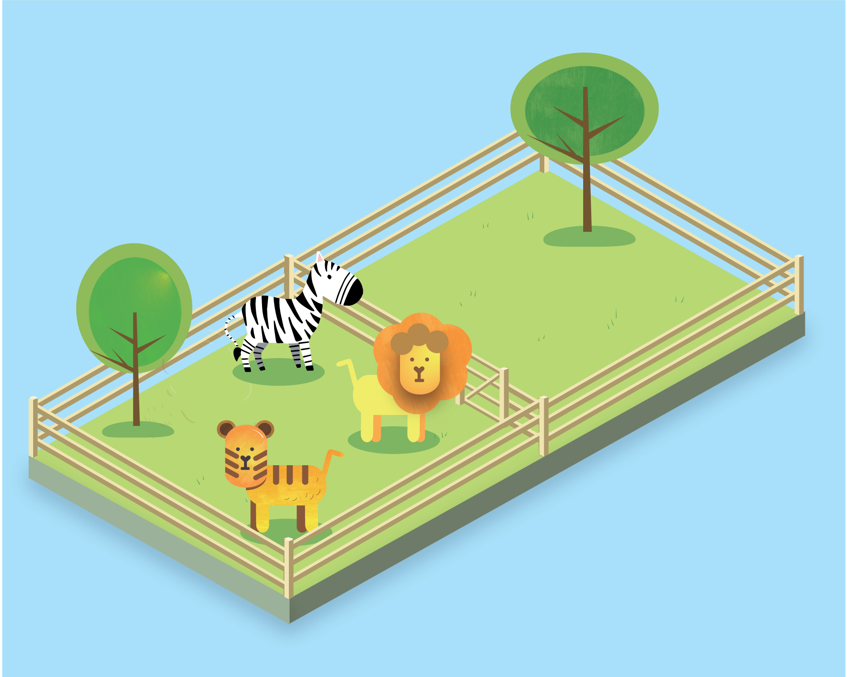
Animal sorting gate
The lion approaches the gate.
Is the animal a big cat?
YES
Does the animal have stripes?
NO
The lion cannot enter the second enclosure.

Slide 5
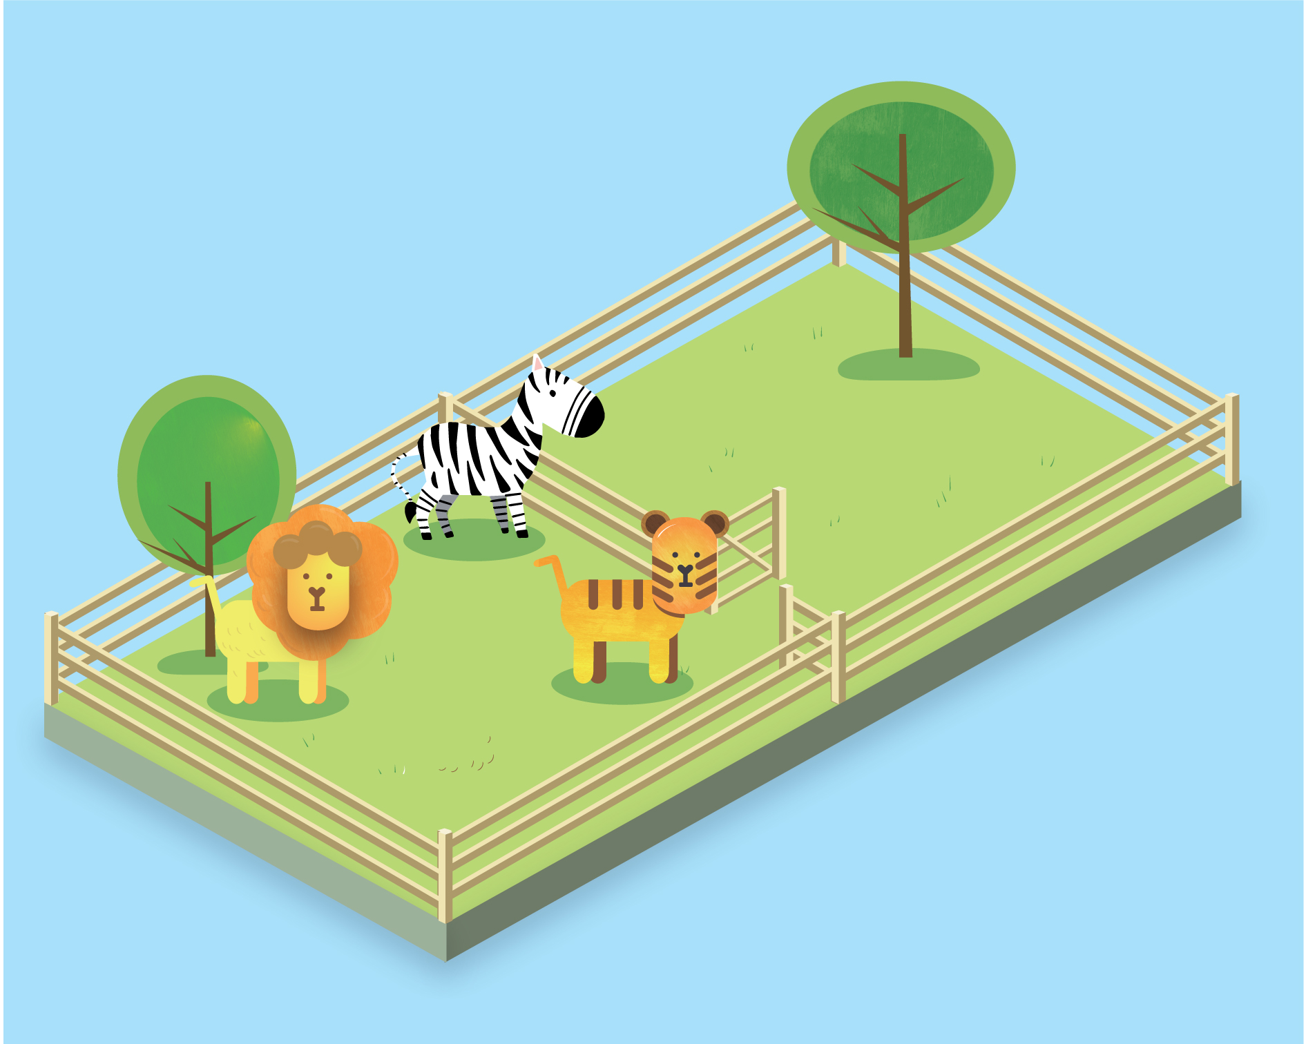
Animal sorting gate
The tiger approaches the gate.
Is the animal a big cat?
YES
Does the animal have stripes?
YES
The tiger can enter the second enclosure.

Slide 6
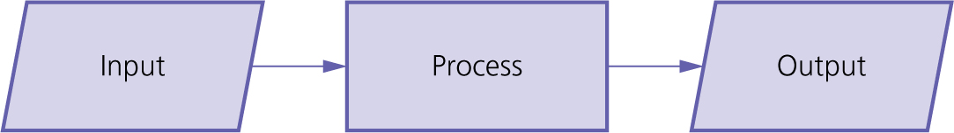
A basic process in computing is:
Input describes data going into a processing system and output describes data leaving a processing system.

Slide 7
Our animal sorting gate receives two inputs:
Is the animal a big cat?
If the answer is YES, this is represented by a 1.
If the answer is NO, this is represented by a 0.
2. Does the animal have stripes?
If the answer is YES, this is represented by a 1.
If the answer is NO, this is represented by a 0.
Our animal sorting gate produces one output:
If both inputs are 1, the gate between the enclosures opens, and this is represented by a 1.
If only one input is 1 or both inputs are 0, the gate between the enclosures remains closed, and this is represented by a 0.

Slide 8
The lion approaches the gate.
Is the animal a big cat?
YES (represented by a 1)
Does the animal have stripes?
NO (represented by a 0)
What is the state of the gate?
CLOSED (the output is 0 so the gate remains closed)
The lion cannot enter the second enclosure.

Slide 9
The tiger approaches the gate.
Is the animal a big cat?
YES (represented by a 1)
Does the animal have stripes?
YES (represented by a 1)
What is the state of the gate?
OPEN (the output is 1 so the gate remains closed)
The tiger can enter the second enclosure.

Slide 10


Think of each input like a switch.
If the switch is turned on, the input is YES and this is represented by a 1.
If the switch is turned off, the input is NO and this is represented by a 0.

Slide 11
The animal sorting gate has two switches, one to identify if the animal at the gate is a big cat and one to identify if animal at the gate has stripes.
These two switches combine to create a logic gate.
Logic gates process two or more inputs and produce the correct output. They make decisions.

Slide 12
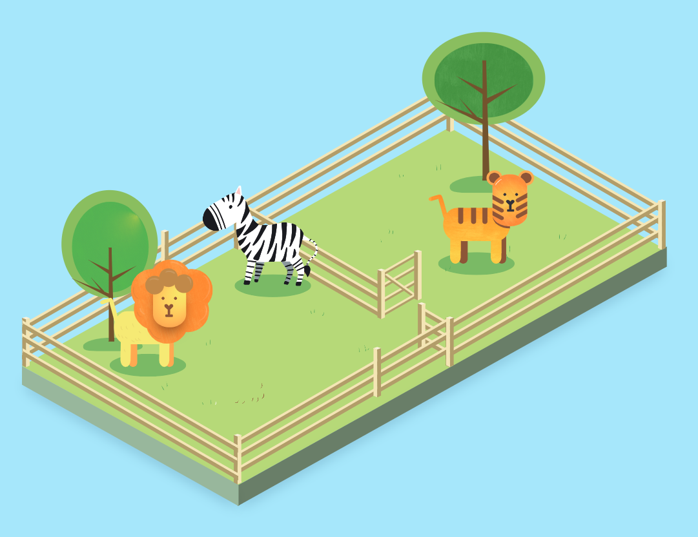
The sorting gate requires two conditions to be met before it will open:
the animal must be a big cat
AND
2. the animal must have stripes.
This logic gate is called an AND gate because both condition 1 AND condition 2 must be met for the gate to open.

Slide 13
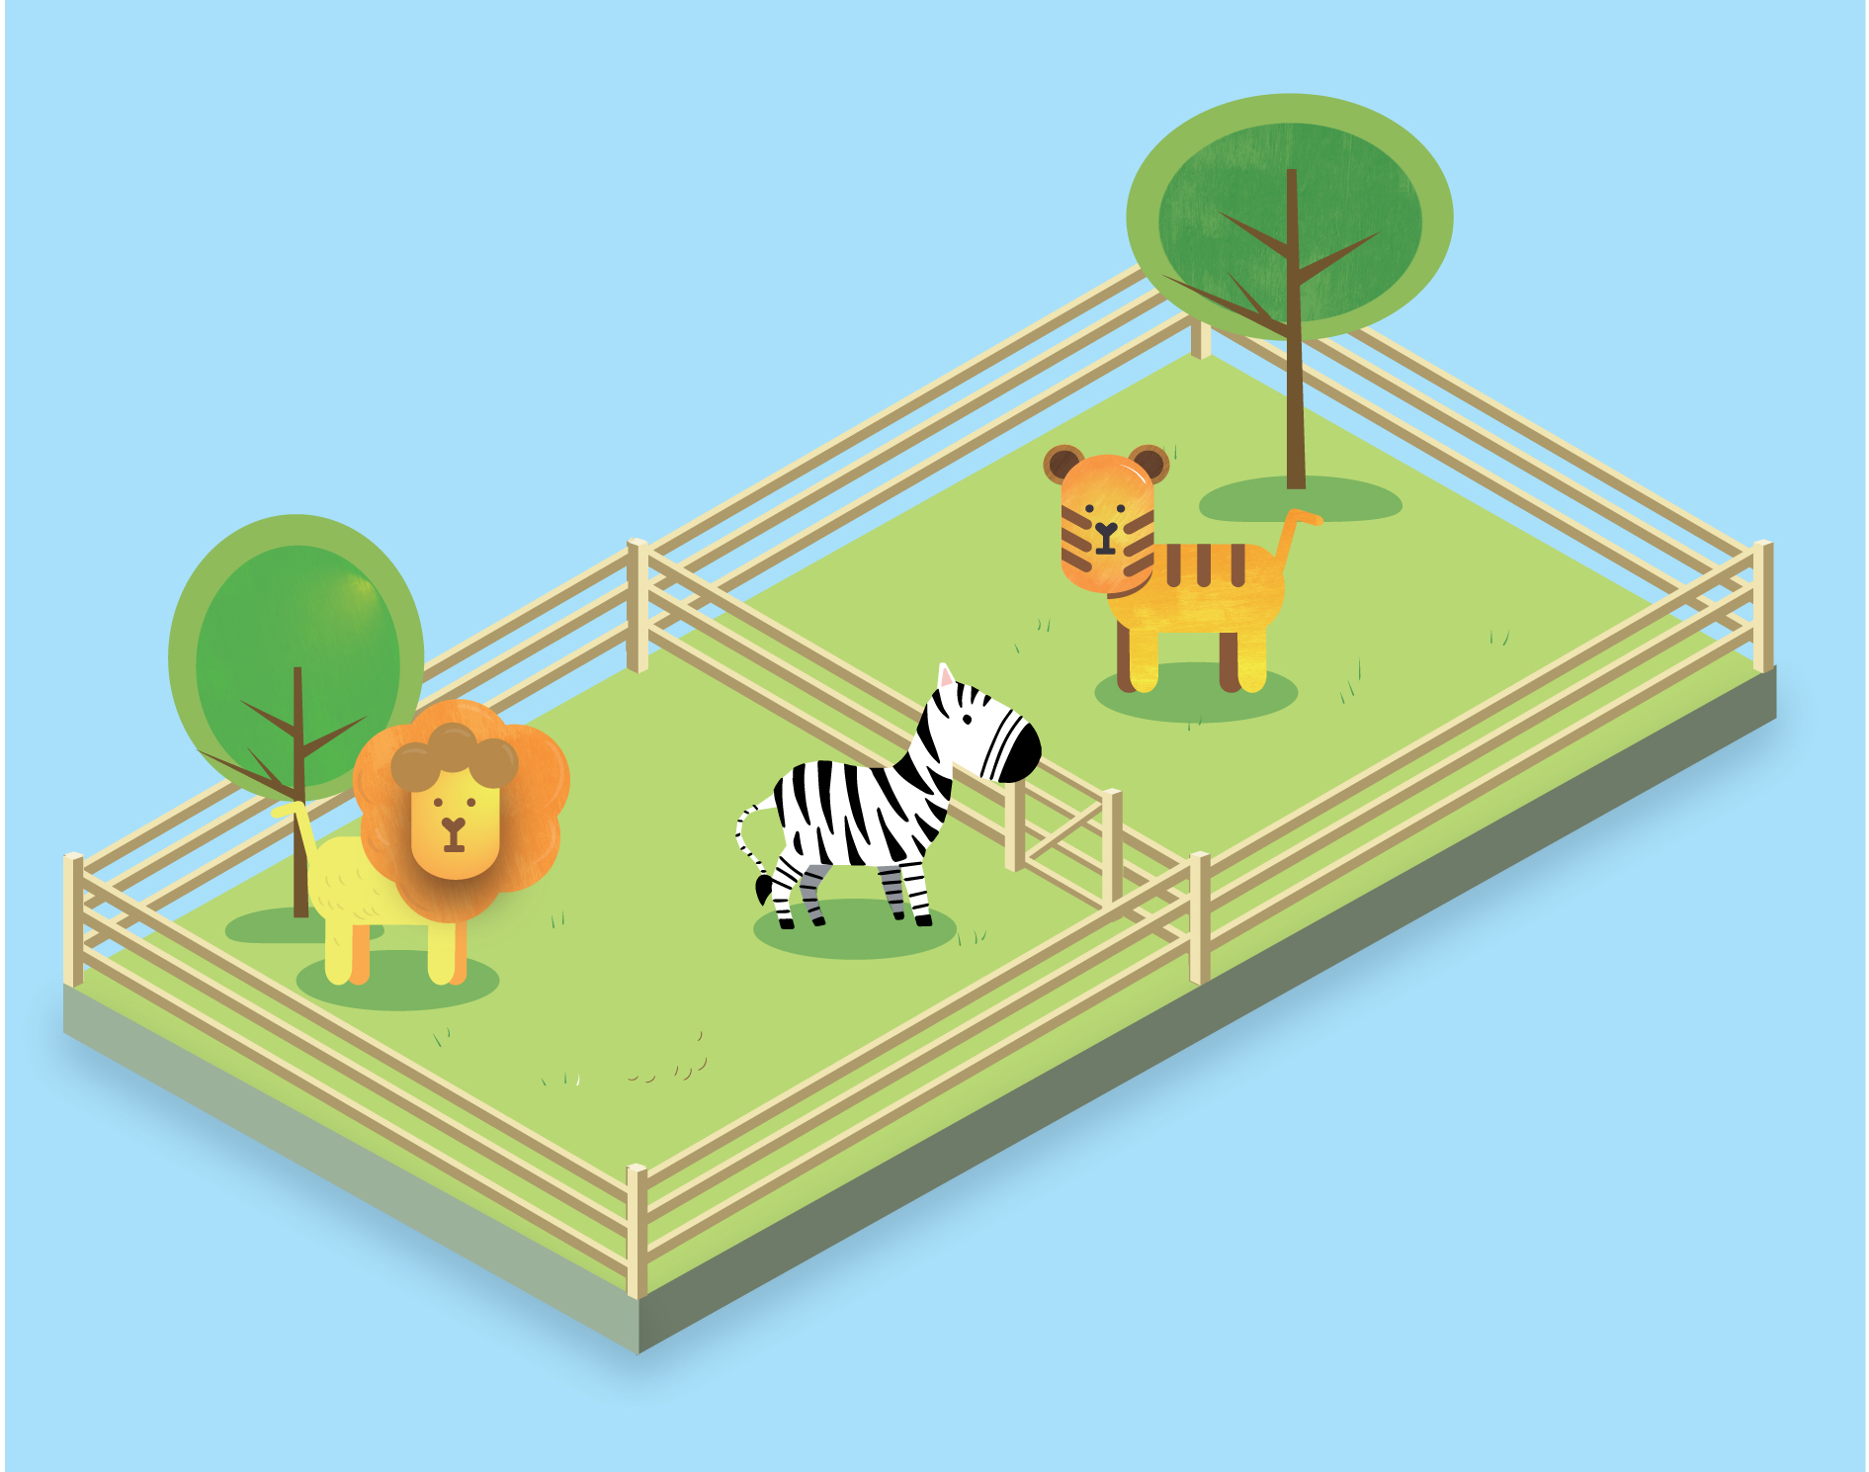

Activity 1.1: Animal sorting gate
The zebra approaches the gate, but the gate remains closed. Why?

Slide 14
Activity 1.2: Circuits

Slide 15
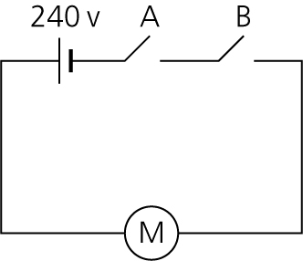
Two-key bank vault circuit
Key A closes switch A and Key B closes switch B.
The circuit diagram shows that both switch A AND switch B have to be closed to turn on the motor that unlocks the safe door.
The logic gate in this circuit is an AND gate, just like the logic gate in the animal sorting gate.

Slide 16
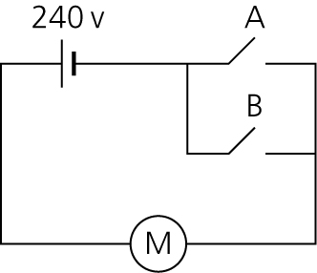
Automatic shop door circuit
It does not matter which sensor switch detects a customer.
The circuit diagram shows that if just one switch is closed, A OR B, the motor will operate to open the door.
The logic gate in this circuit is an OR gate.

Slide 17
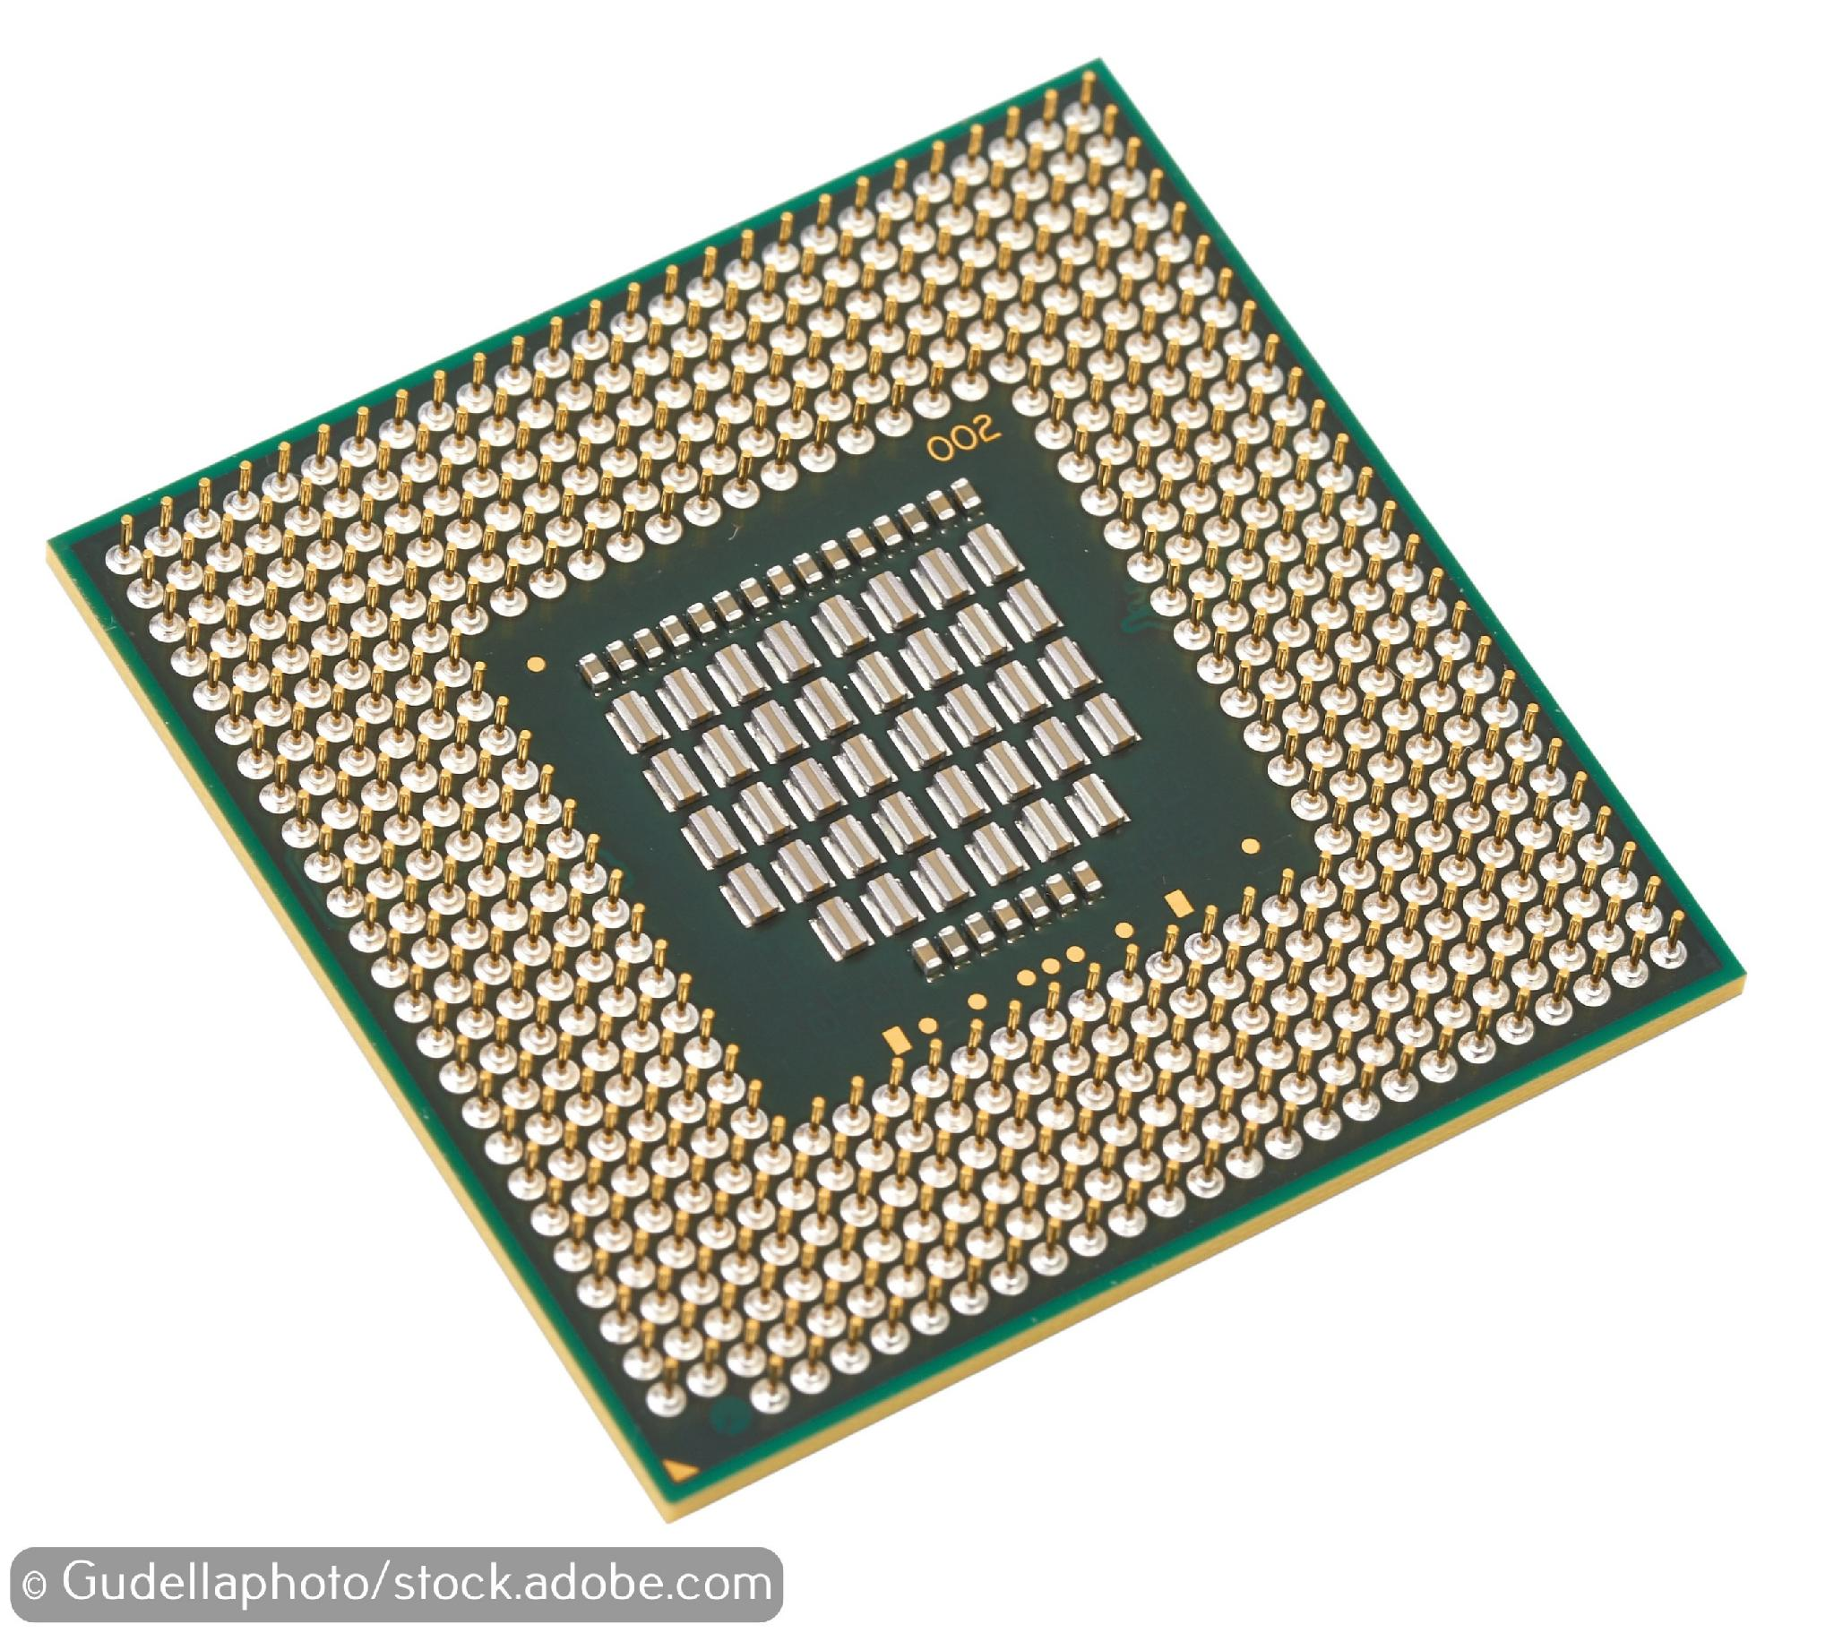
Central processing unit
The central processing unit of a computer, the CPU, is built from millions of electrical circuits containing logic gates.
When a computer is processing, each one of the millions of electrical circuits compares two items of data (the inputs) and makes a decision (the output).
The output from one electrical circuit often becomes one of the inputs for another electrical circuit.
The outputs result in the actions you can see on screen.

Slide 18
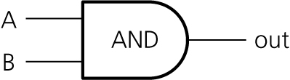
AND gate symbol
This is the standard symbol for the AND gate:
The inputs come in the form of two electrical currents, A and B. Each current flows into a switch.
When an input switch in the logic gate is open, the electrical current flows and this is represented by a 1.
When an input switch in the logic gate is closed, the electrical current does not flow and this is represented by a 0.
If input A is 1 AND input B is 1, the output is 1. Otherwise, it is 0.

Slide 19
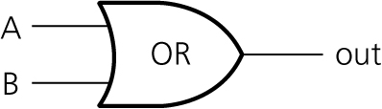
OR gate symbol
This is the standard symbol for the OR gate:
If input A is 1 OR input B is 1, the output is 1. Otherwise, it is 0.

Slide 20
Truth tables
Logic gates are called logic gates because their operation is entirely logical and predictable.
The operation of a particular gate can, therefore, be summarised in a table, known as a truth table.
Truth tables describe how a computer processes data.

Slide 21
Activity 1.3: Truth tables

Slide 22
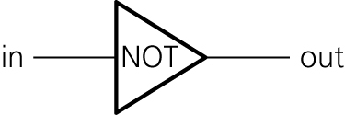
The NOT gate
If the input from a sensor or the output from a logic gate needs to be the opposite of what it currently is, we can add a NOT gate – also called an inverter – to switch 1 to 0 or 0 to 1.
Here is the standard symbol for the NOT gate:

Slide 23
Activity 1.4: Street light

Slide 24
Quiz 1

